Slide 1
ONLINE MOVIE TICKET BOOKING

Slide 2
RLL project PRESENTATION on
ONLINE MOVIE TICKET BOOKING
Presented By Group - 07
NAME | ID
Angel Reginald Lenin | 2530061
Sushmitha P | 2528316
Harshini A | 2529917
Heera Mani K B S | 2530164
Manushree N | 2528297
Palepu Suresh Kumar | 2528737
Muradsabgari Shaik Firoz | 2528275
Kottagundla Sai Bhargav | 2528380
Jeevapradhap J | 2530349

Slide 3

TABLE OF CONTENTS
Introduction
Background of the project
Tools & Technologies
ER Diagram
Admin Module
User Module
Outputs

Slide 4
INTRODUCTION
The project gives a real-life understanding of the online movie ticket booking system and activities performed by various roles in the supply chain.
Here we provide automation for the movie ticket booking system through the internet.
Online movie ticket booking system project captures activities performed by different roles.

Slide 5
BACKGROUND OF THE PROJECT
NMS CINEMAS
NMS Cinemas is a chain of single-screen theatres that screen movie shows of different genres and languages at very genuine prices.
They found out that the online booking of movie tickets from apps, such as BookMyShow and Paytm were gaining more profit by eliminating middlemen from the equation.
As a result, the team decided to hire a Full Stack developer to develop an online movie ticket booking web application with a rich and user-friendly interface. You are hired as the Full Stack Java developer and are asked to develop the web application.
The management team has provided you with the requirements and their business model so that you can easily arrange different components of the application.

Slide 6

TOOLS AND TECHNLOGIES
Front End: Angular 13/HTML/CSS
Server-Side: Spring Boot
Backend: MySQL, Hibernate
Operating System: Windows 10/11
Developing Method: Agile Methodology

Slide 7


PORTAL
ADMIN
USER

Slide 8
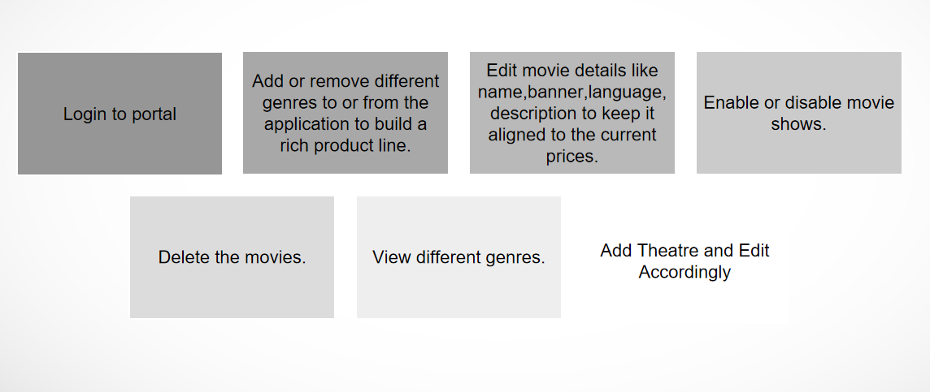
ADMIN ROLE

Slide 9
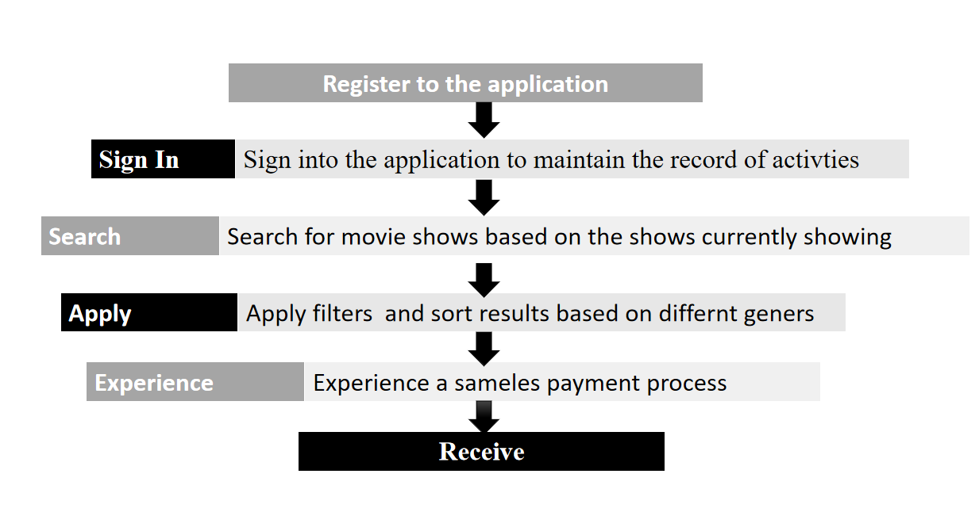
USER ROLE

Slide 10
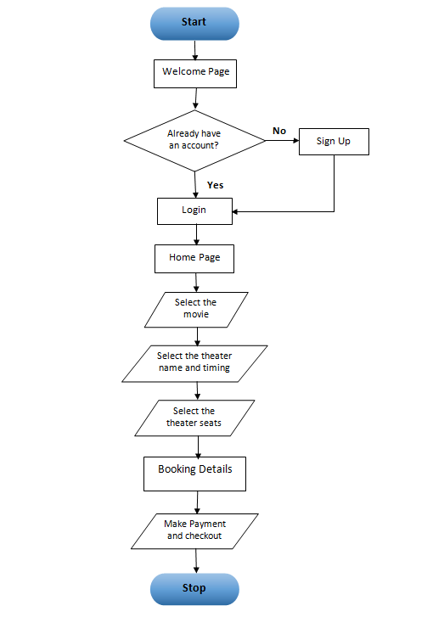
Flow Chart

Slide 11
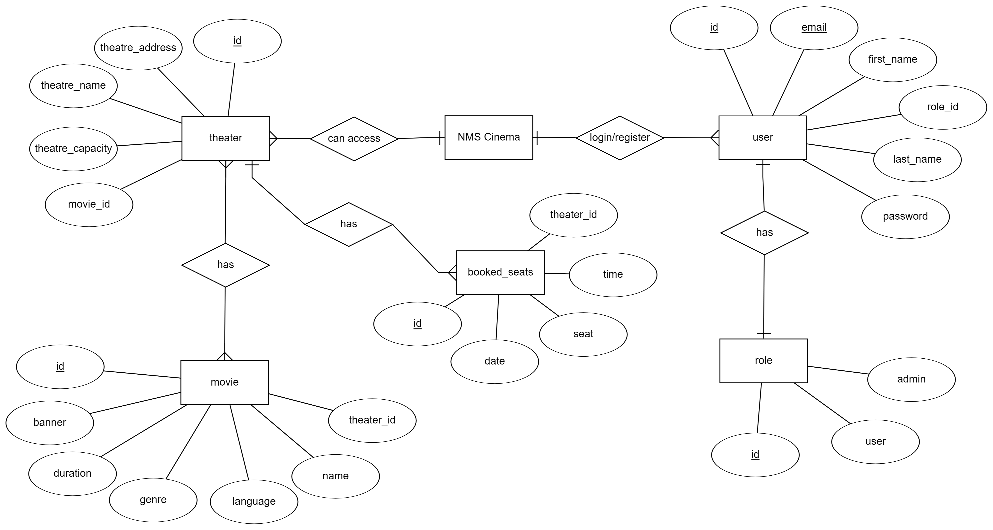
ER-DIAGRAM

Slide 12
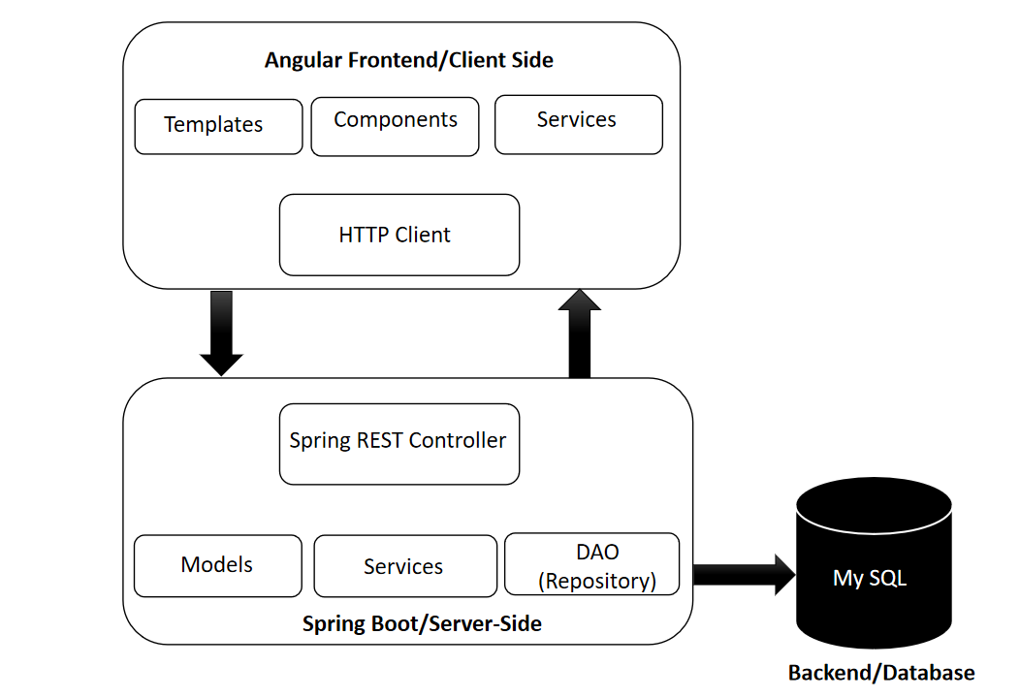
Model used

Slide 13
BACK-END

Slide 14
TOOLS/TECHNOLOGIES USED
ECLIPSE IDE
MYSQL
HIBERNATE
SPRING BOOT
POSTMAN

Slide 15
CONTROLLERS
User controller
Movie controller
Theatre controller
Booked seat controller
Payment controller

Slide 16
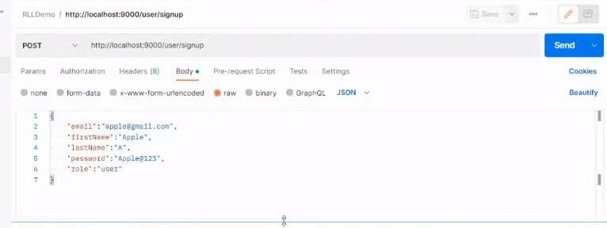
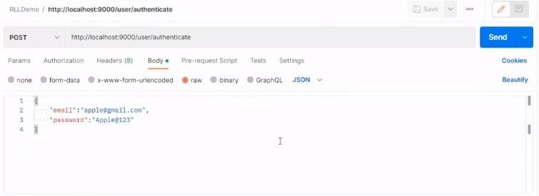
USER CONTROLLER

Slide 17
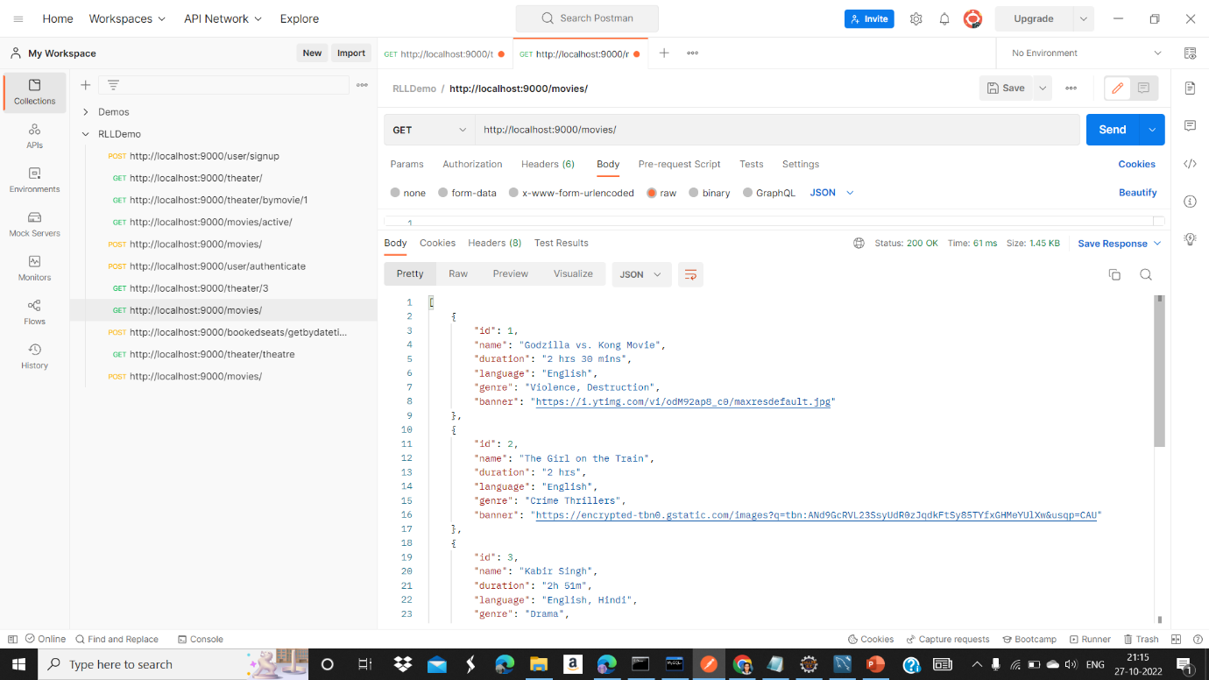
MOVIE CONROLLER

Slide 18
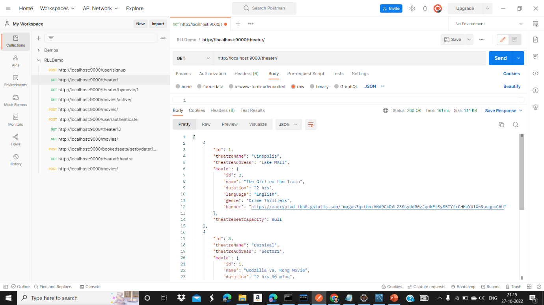
THEATRE CONTROLLER

Slide 19
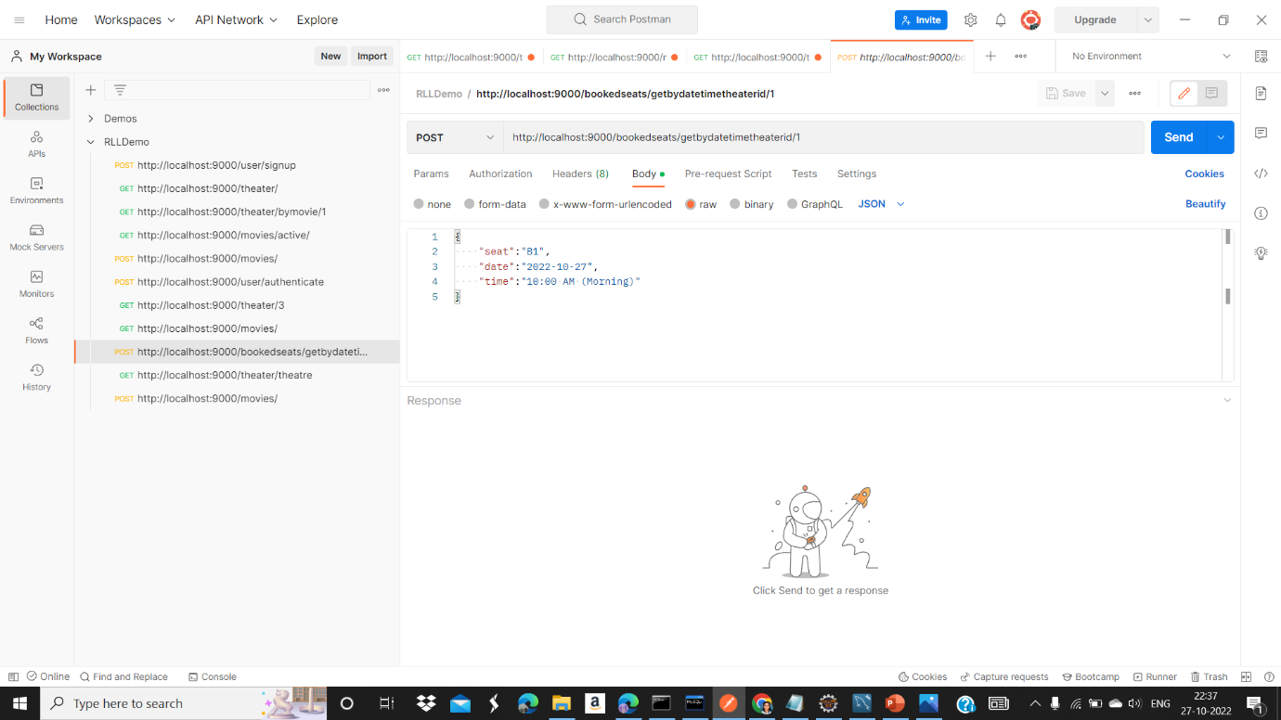
BOOKED SEAT CONTOLLER

Slide 20
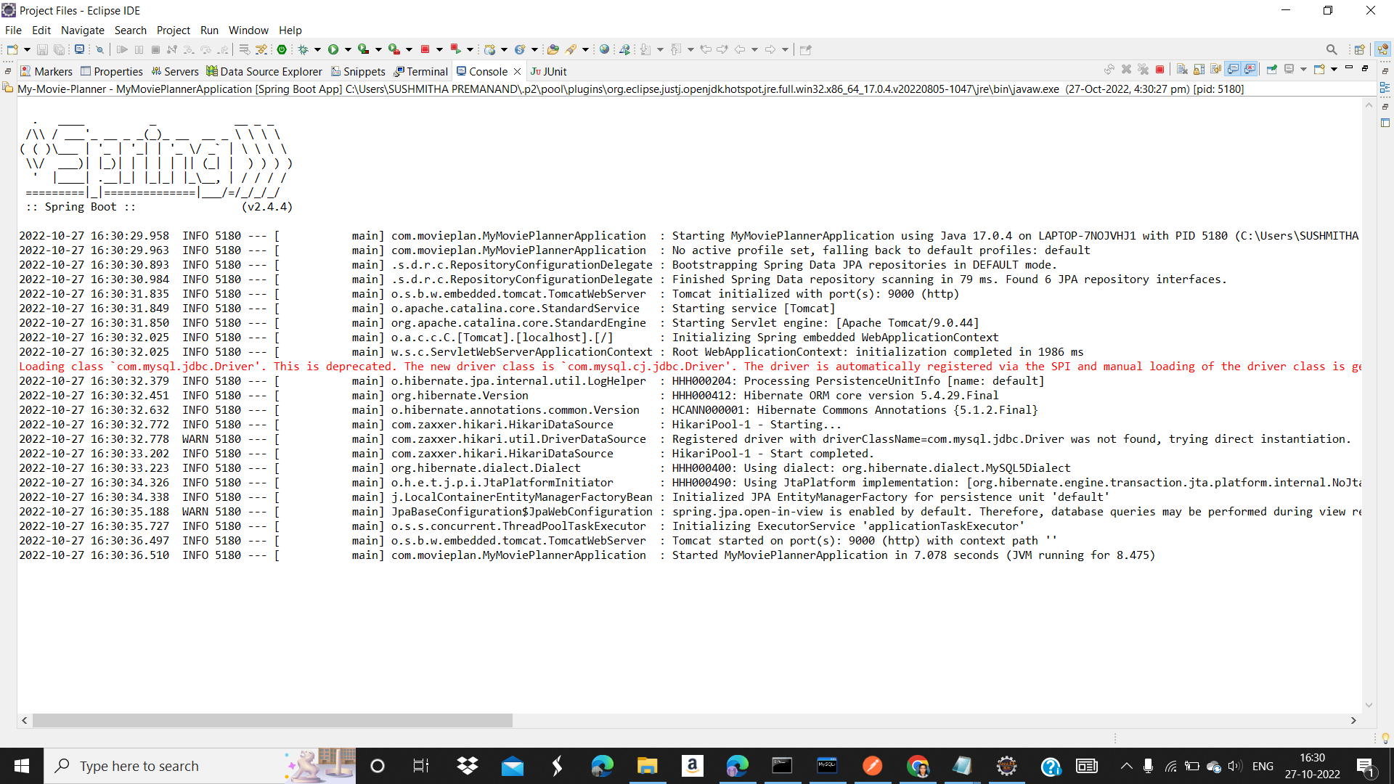
BACKEND EXECUTION

Slide 21
FRONT END

Slide 22
TOOLS/TECHNOLOGIES USED
Angular
HTML
CSS
Visual studio code

Slide 23
COMPONENTS IN ANGULAR
Signup
Login
Home
Header
Admin movies

Slide 24
Admin theatres
Add movie
Add theatre
Edit movie
Edit theatre
Active show

Slide 25
Seat-booking
Booking confirmation
Nms cinemas
Payment
Payment page

Slide 26
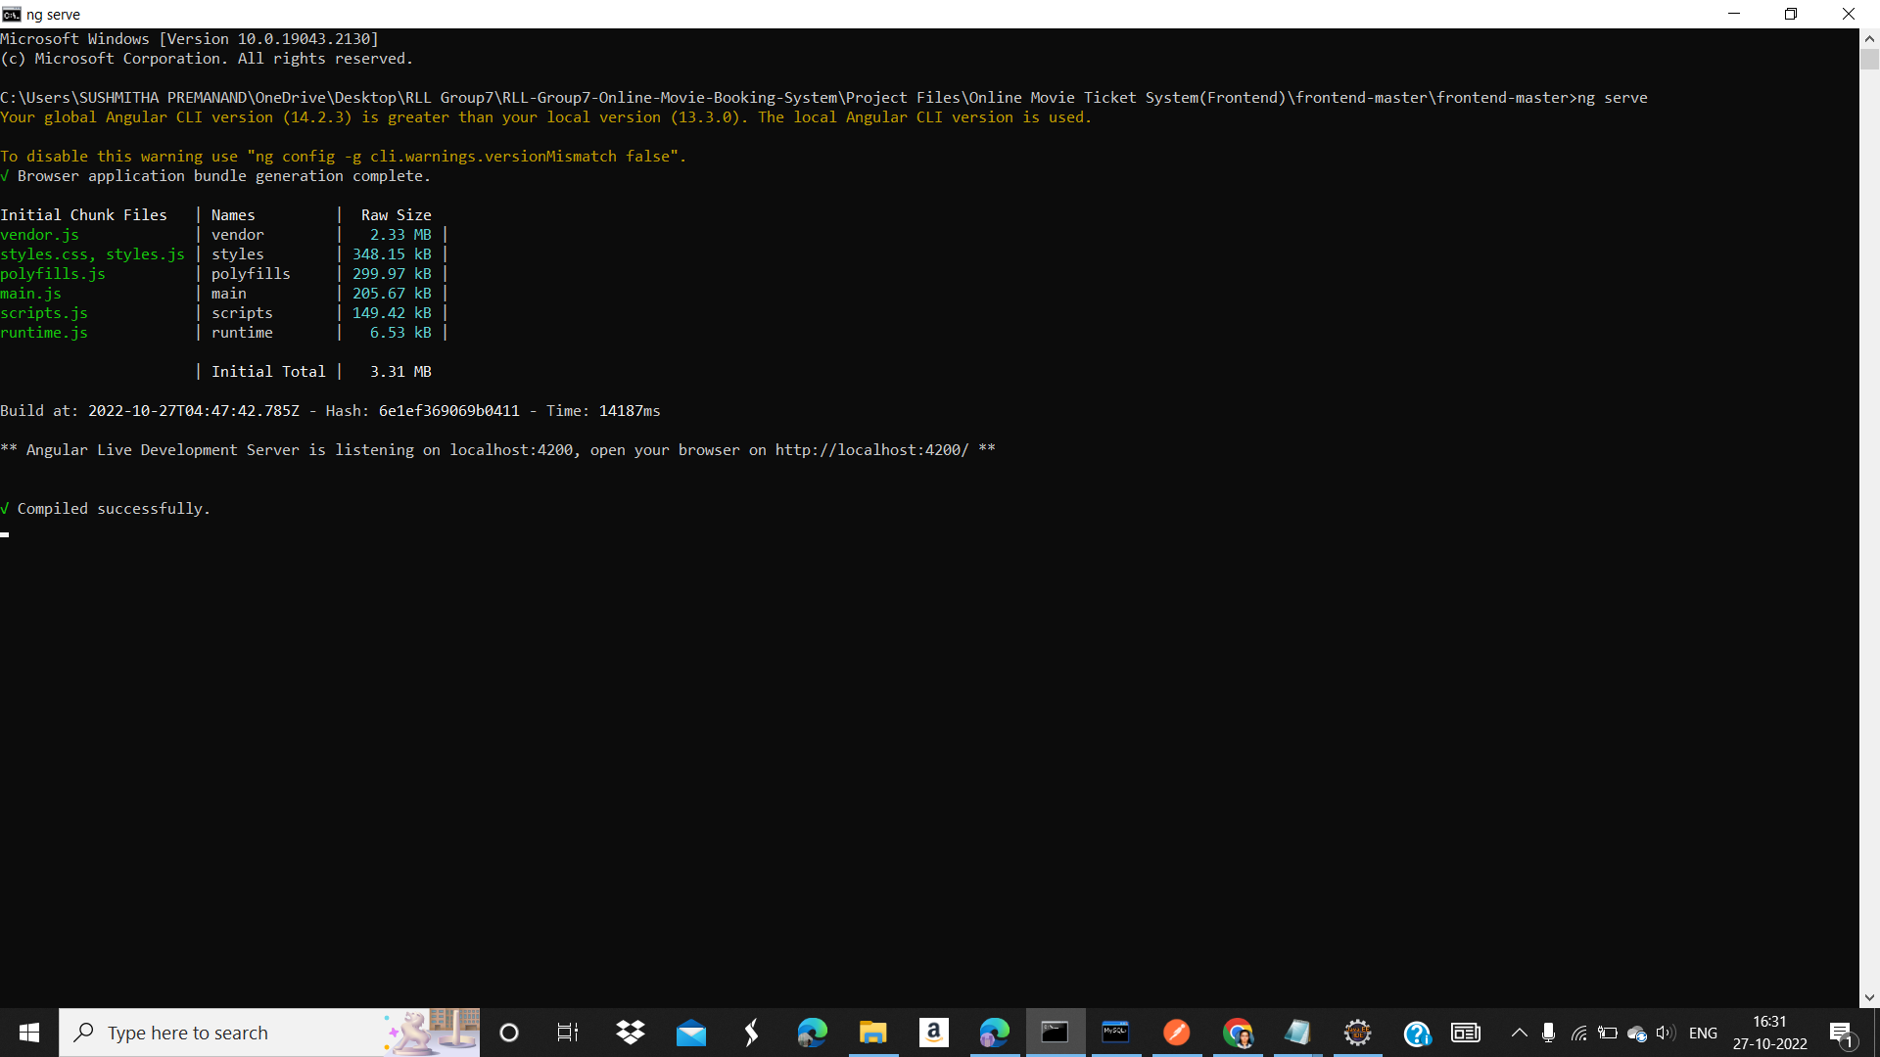
FRONT-END EXECUTION

Slide 27
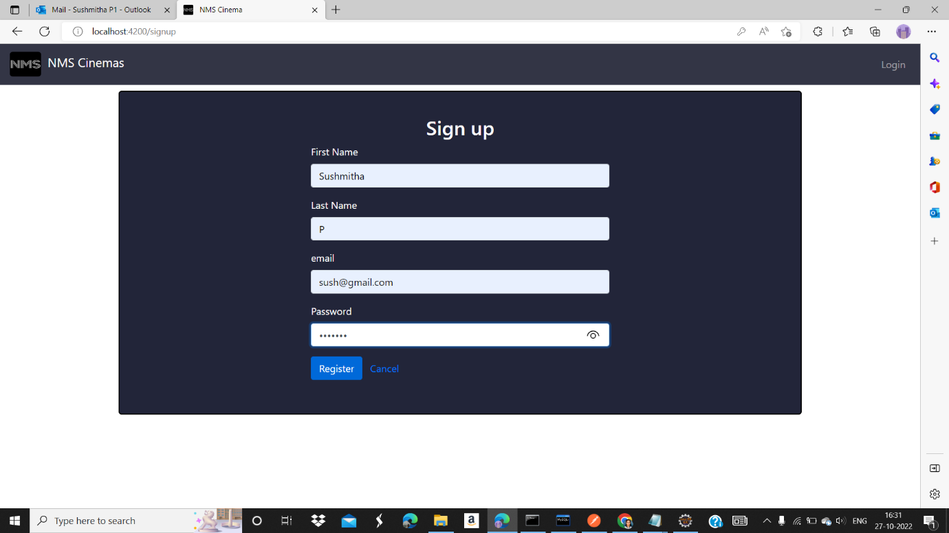
SIGN UP

Slide 28
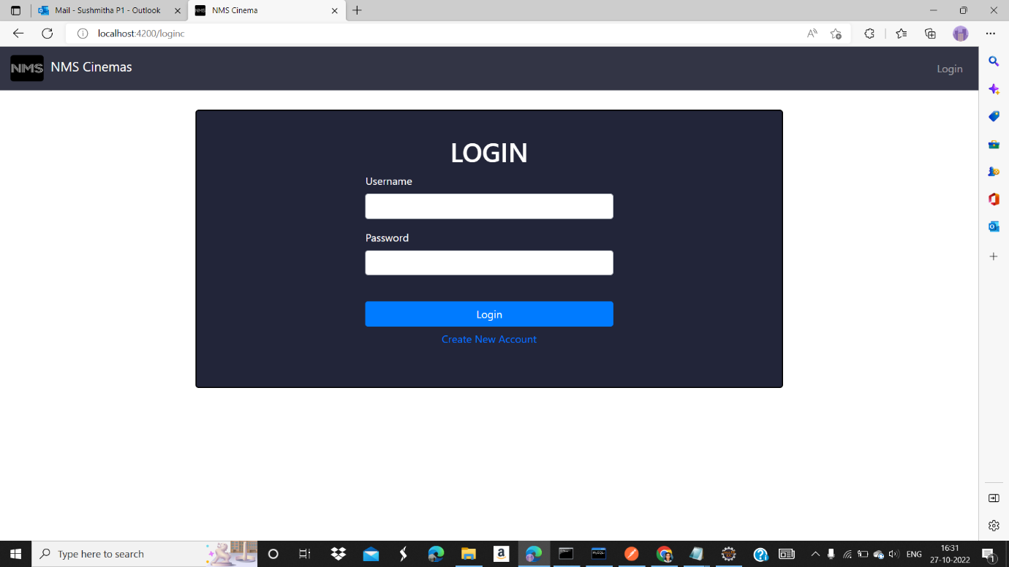
LOGIN PAGE

Slide 29

USER LOGIN PAGE

Slide 30

ADMIN ACTIVITIES

Slide 31
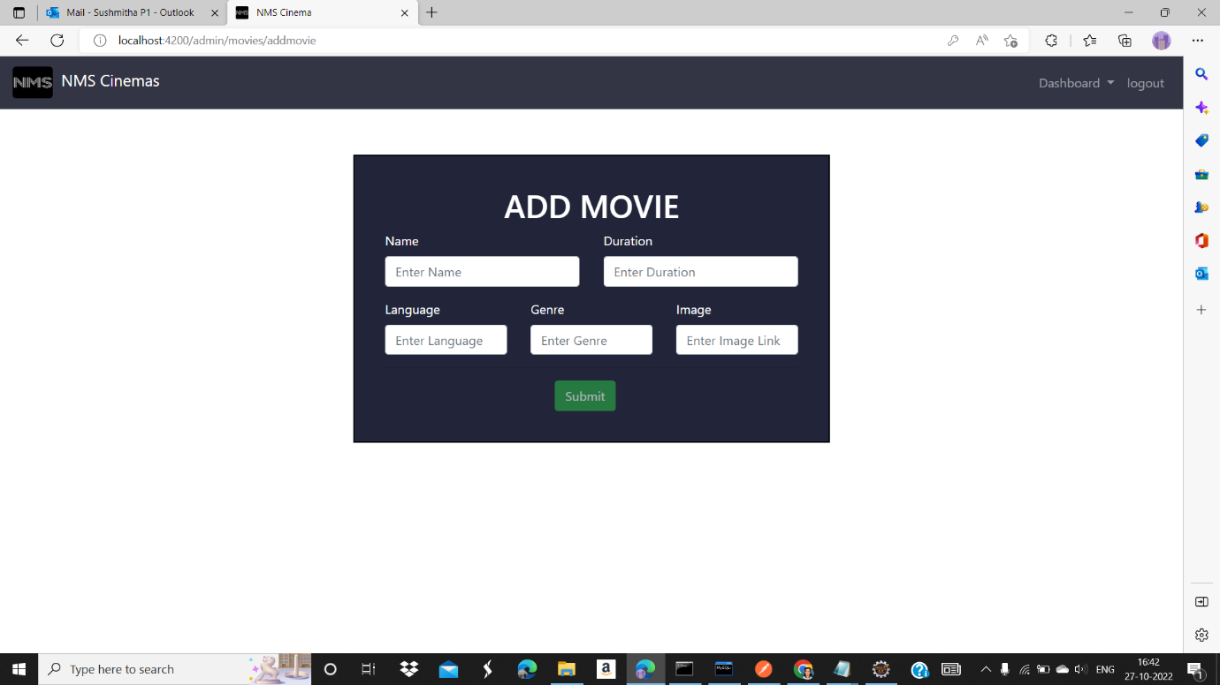
ADMIN – MOVIES

Slide 32
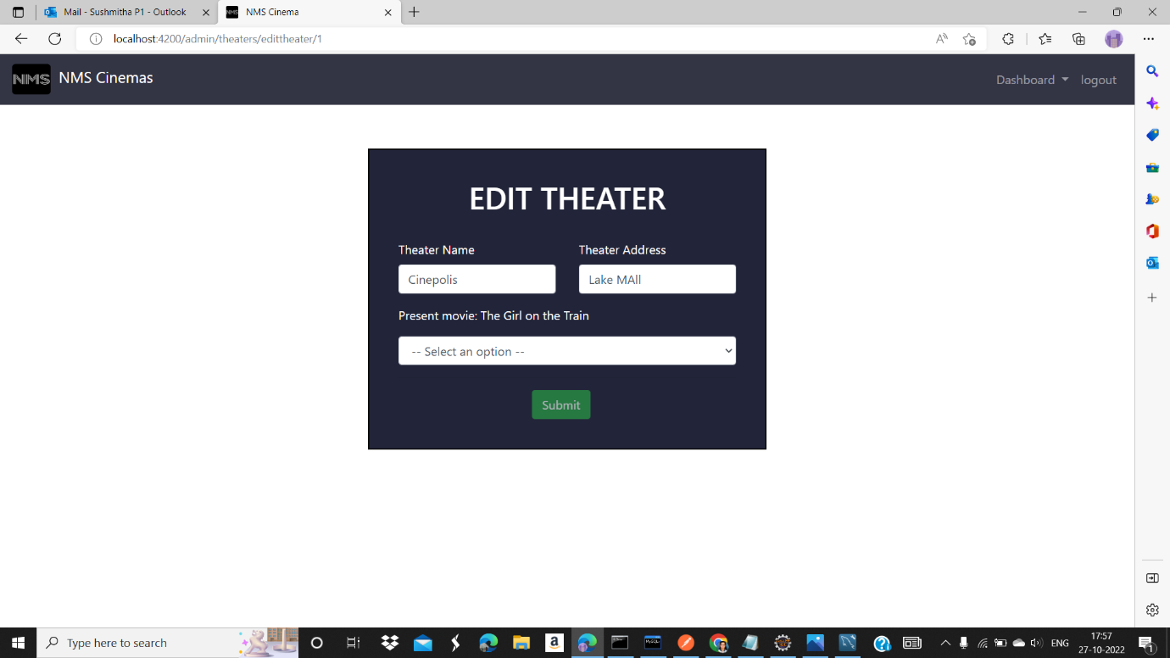
ADMIN – THEATERS

Slide 33
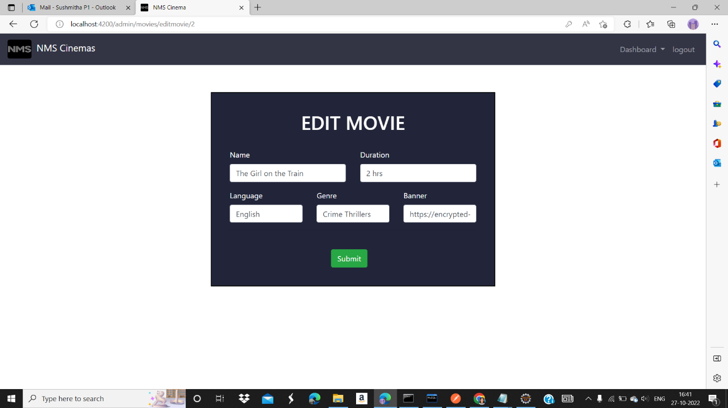
EDIT MOVIES

Slide 34
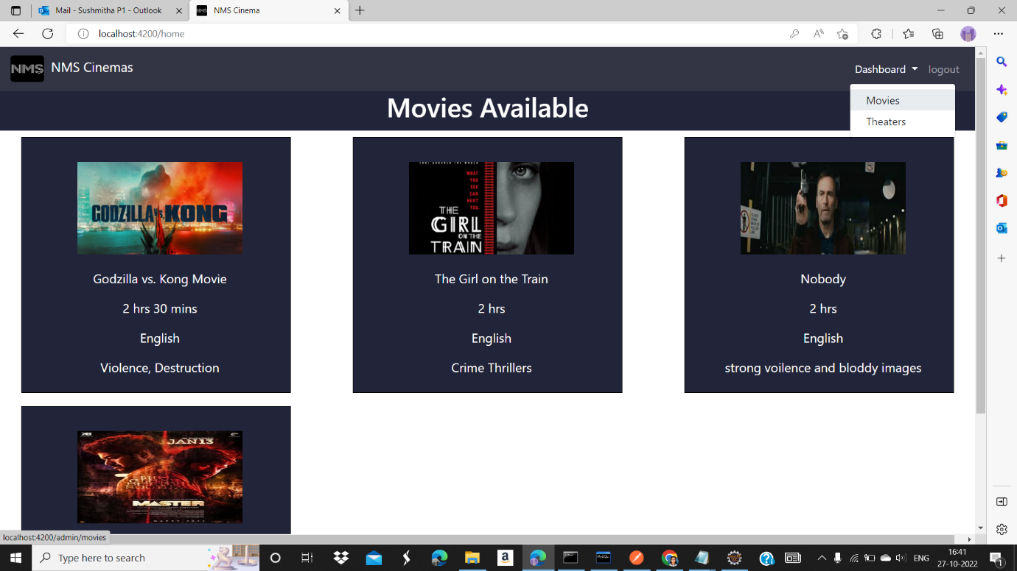
MOVIES AVAILABLE

Slide 35
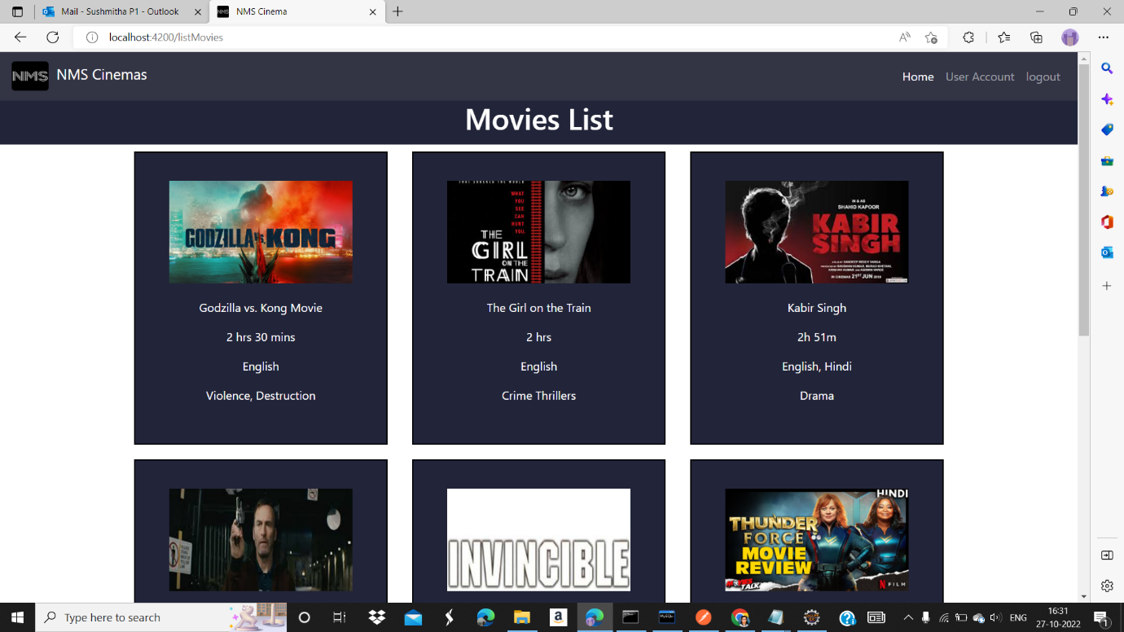
MOVIE LIST

Slide 36
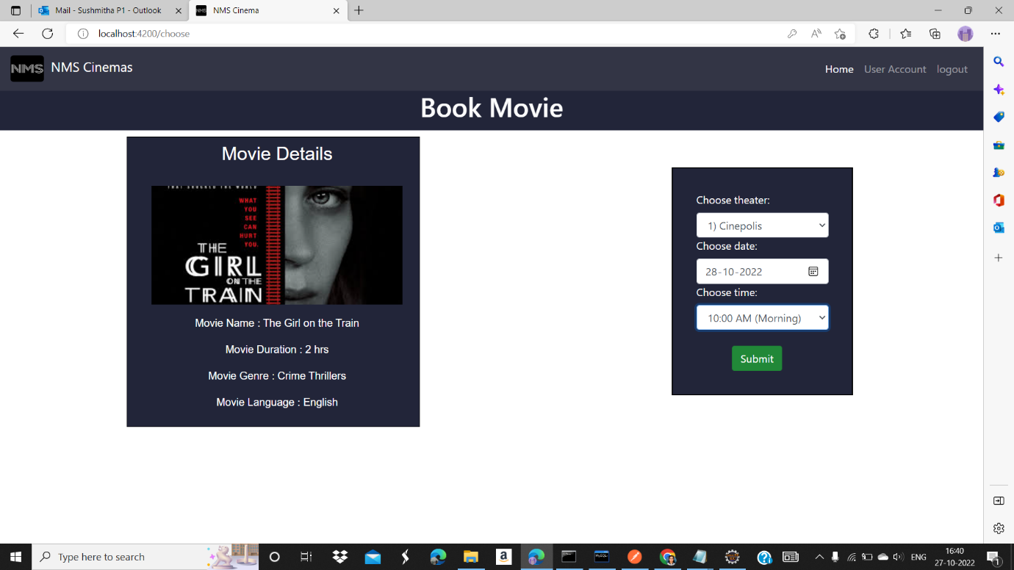
BOOK MOVIE

Slide 37
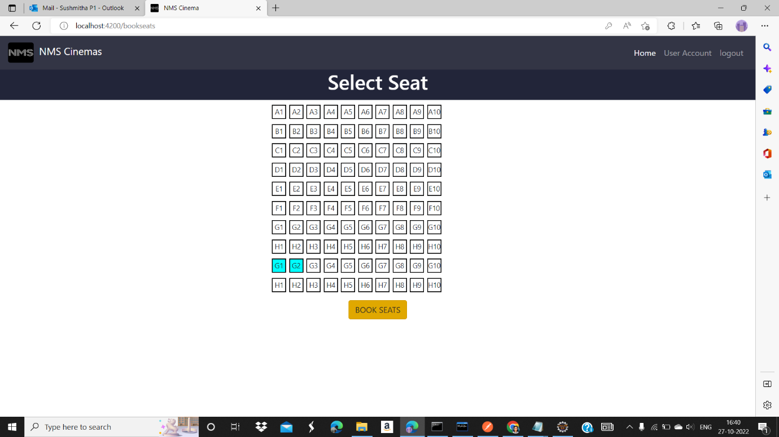
SELECT SEAT

Slide 38
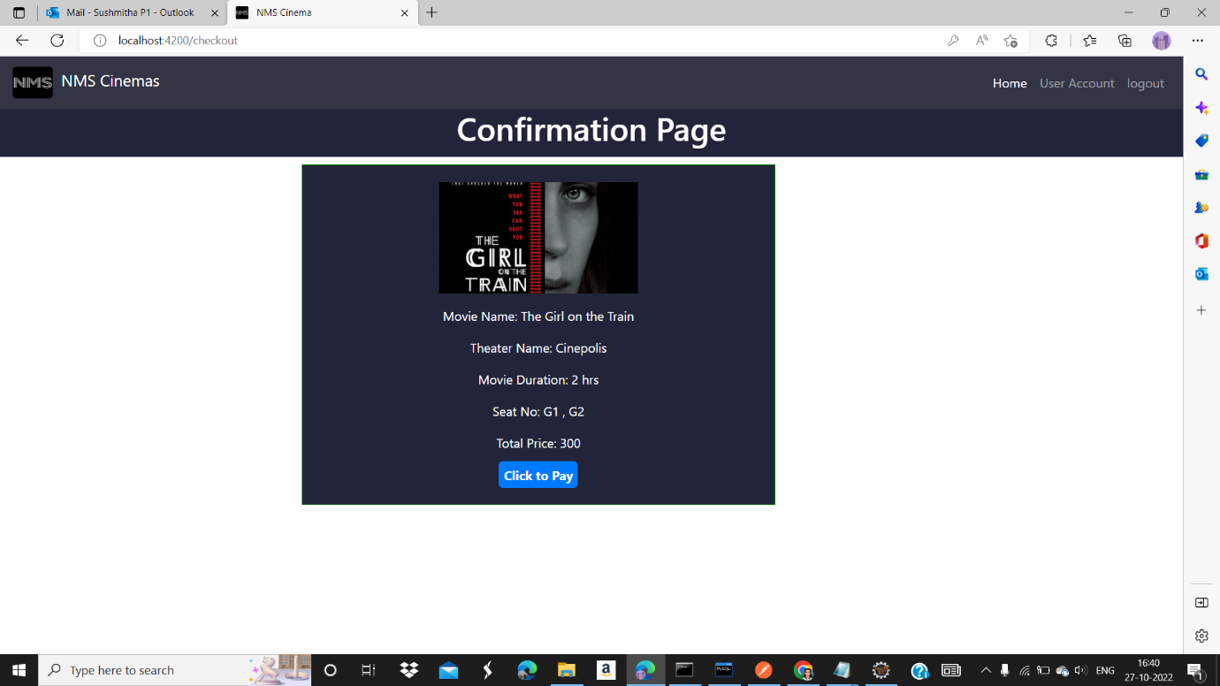
CONFIRMATION PAGE

Slide 39
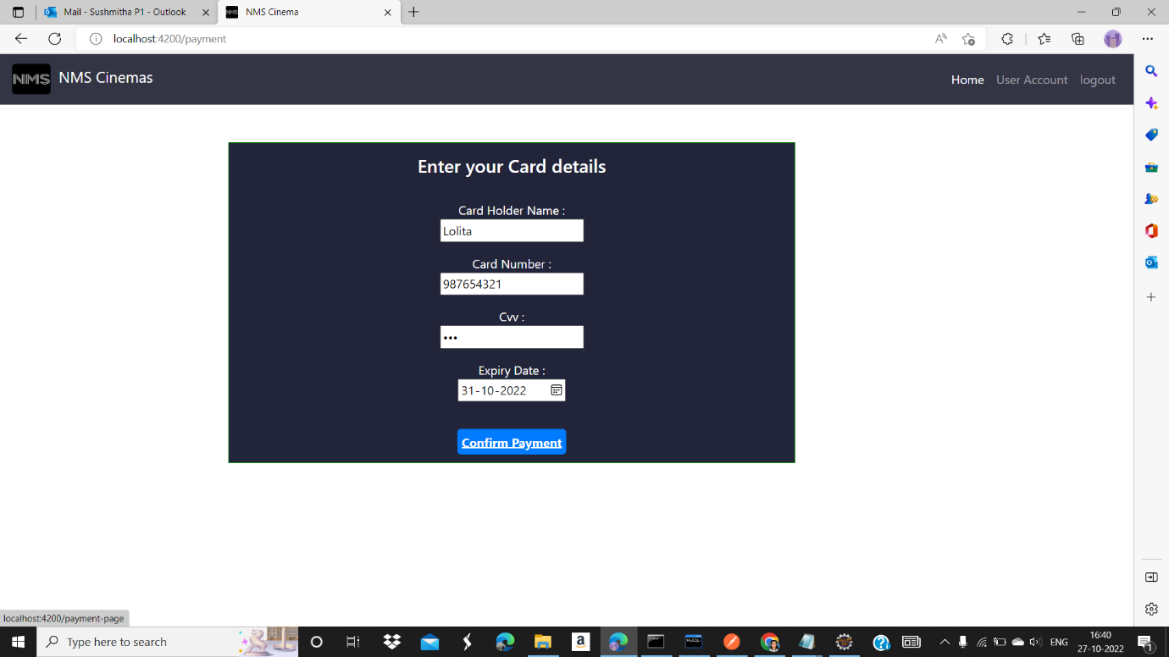
CARD DETAILS

Slide 40
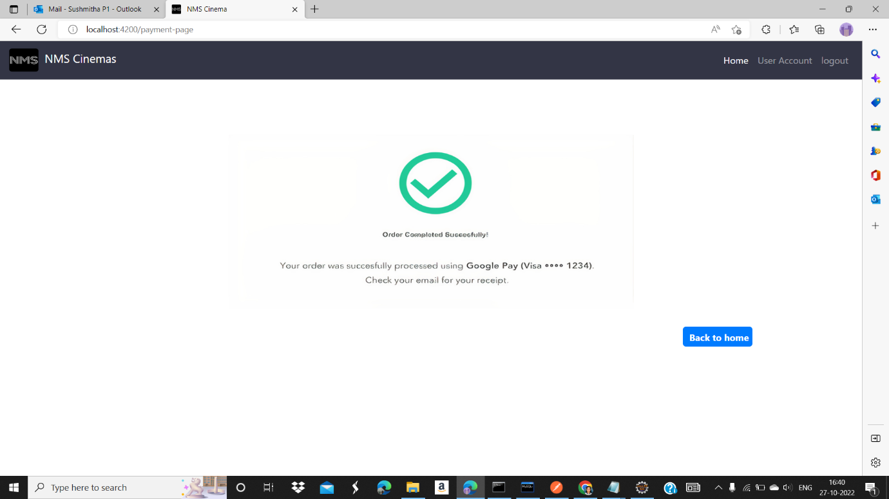
PAYMENT STATUS

Slide 41
TESTING

Slide 42
J UNIT TESTING
J Unit is a Regression Testing Framework used by developers to implement unit testing in Java, and accelerate programming speed and increase the quality of code.

Slide 43
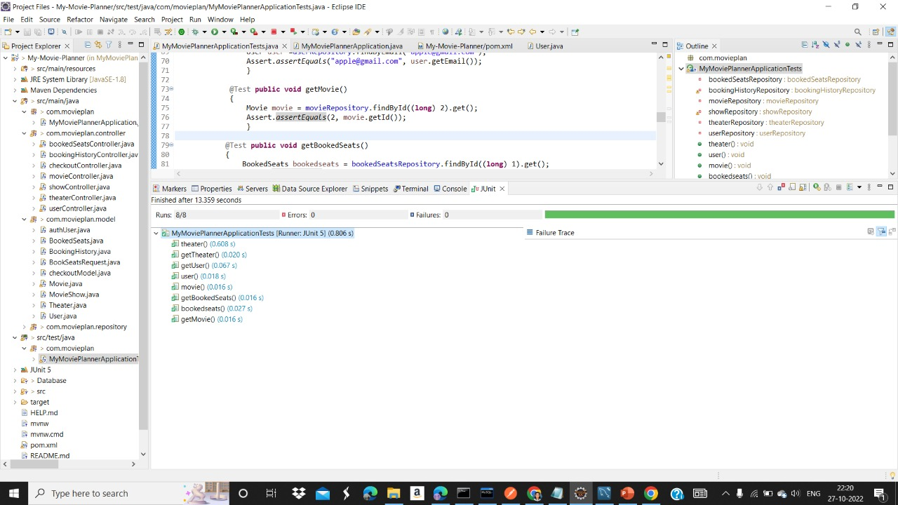
OUTPUT OF J UNIT TESTING

Slide 44
LETS SEE THE EXECUTION OF CODE...

